Slide 1



DNS Cache Poisoning Attack Reloaded: Revolutions with Side Channels
Zhiyun Qian, Youjun Huang, Zhongjie Wang
Haixin Duan, Keyu Man, Xiaofeng Zheng
Paper presentation by,
Vaibhav Singh

Slide 2
Agenda
Background
How does DNS resolution work?
What is Cache poisoning?
Historical info - The Kaminsky vulnerability
Proposed Attack
Part 1 : Infer ephemeral ports
Part 2 : Extend attack window
Defenses
Related Work

Slide 3
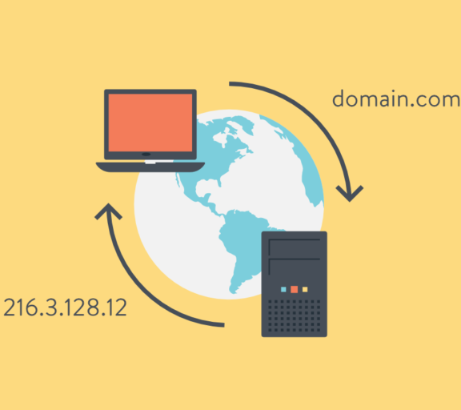
Background

Slide 4
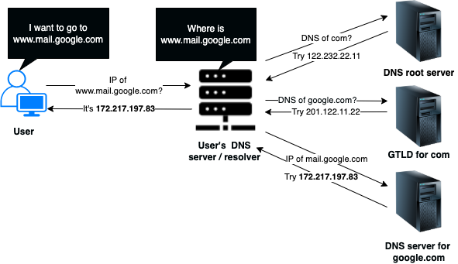
How DNS resolution works ? “I know someone who knows someone you want to know!!”
Notes:
Diagram
nslookup mail.google.com
cat /etc/resolv.conf
scutil –dns
NS records
A records
nslookup
server 8.8.8.8

Slide 5
“At any instant there are hundreds of such ongoing queries!!!”
So, what’s the key recipe missing here which would differentiate one from another?

Slide 6
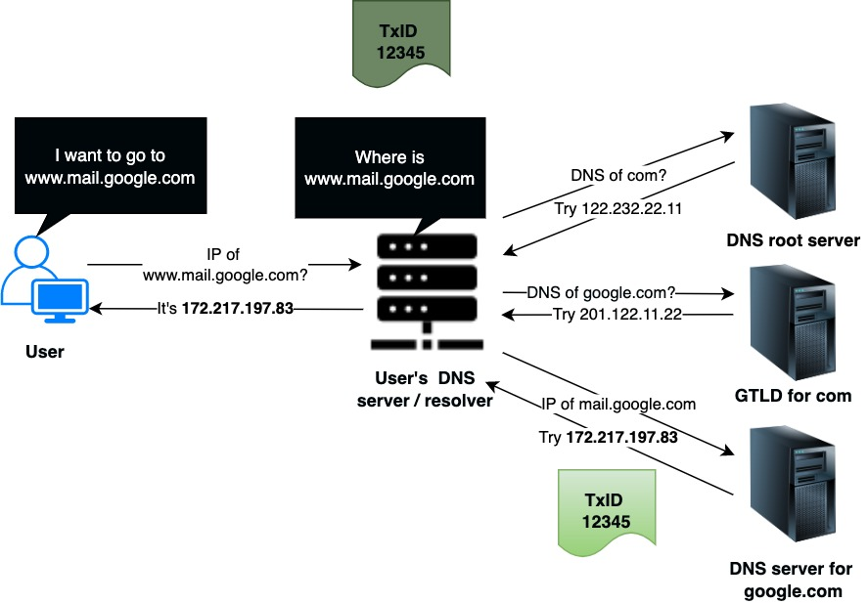
Query / Transaction ID (16-bit identifier)

Slide 7
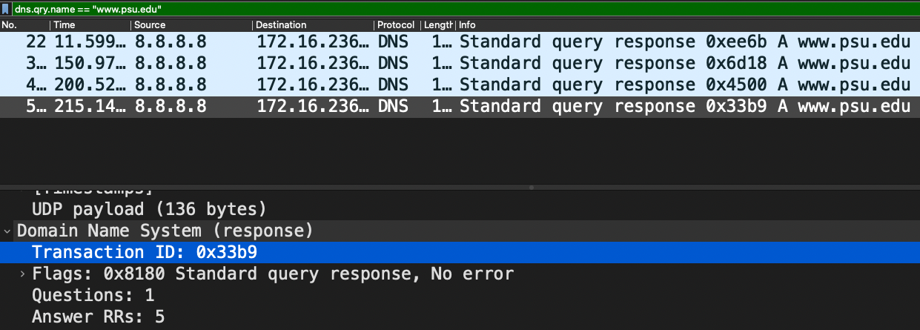

Slide 8
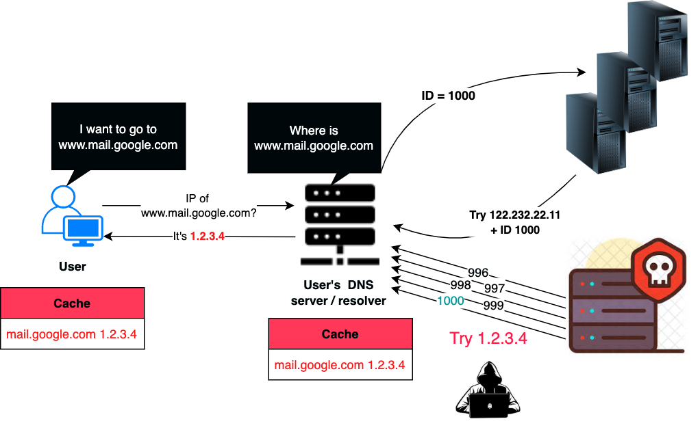
What is Cache Poisoning?
Notes:
This issue was spotted and TXID was randomized – At this point we had 16 bits of randomness
chance of hitting is much lesser

Slide 9
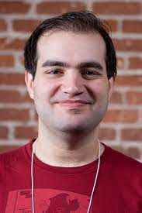
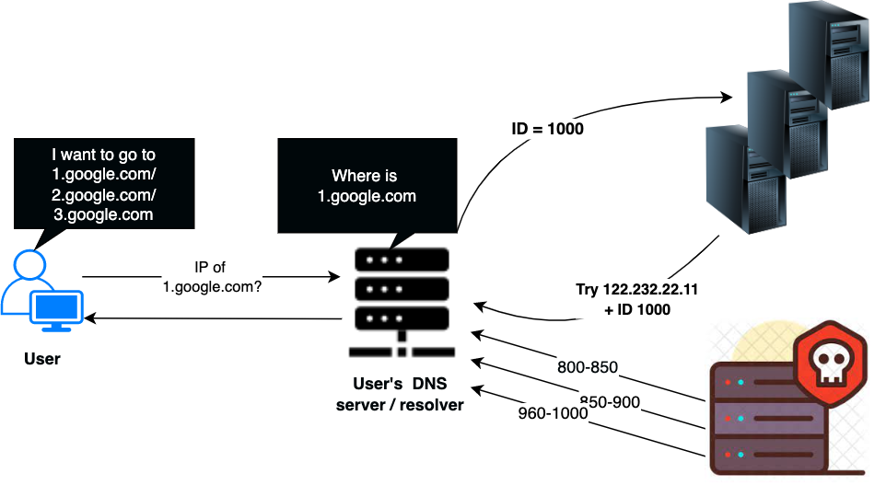
The Kaminsky vulnerability

Slide 10
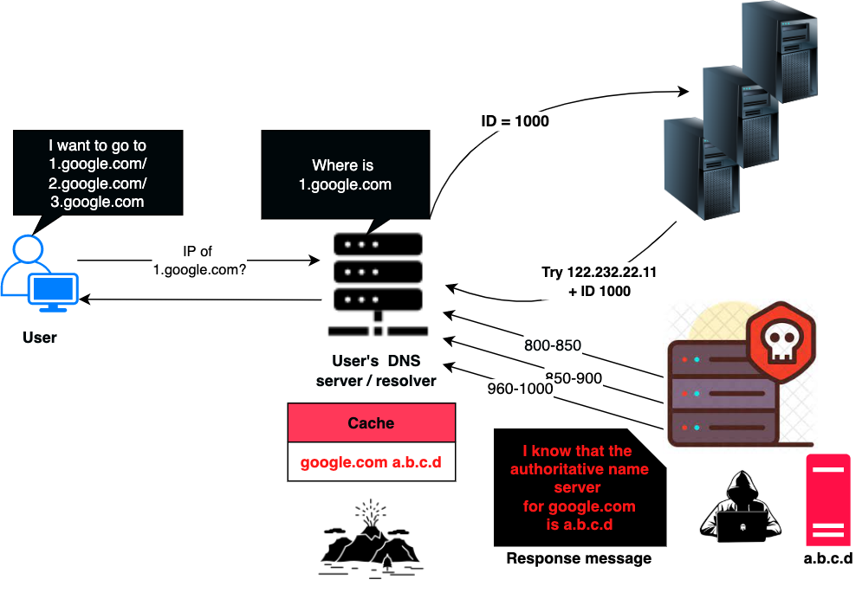

Slide 11

Almost all major nameservers were affected except the one built by German researcher – Dan J Bernstein
who had warned about this in 1999!!!
So, anyone knows what was the solution chosen back then?
Any guesses!!
Hint – Increase randomness!!
https://www.youtube.com/watch?v=B-v_wJIJUI4&t=2s
Notes:
Paul Vixie convened the group!

Slide 12
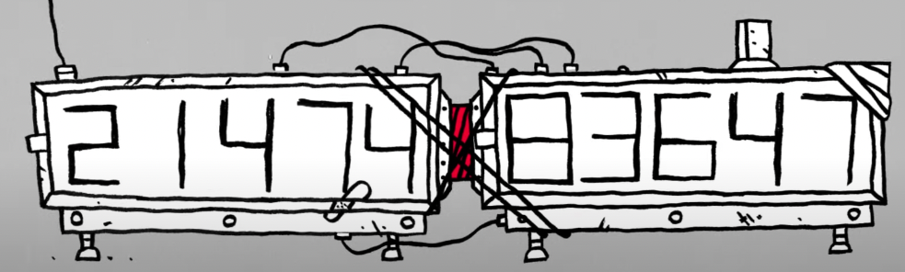
The chosen defense
Use the 16 bits of UDP source port to increase the randomness to 32 bits
https://www.youtube.com/watch?v=B-v_wJIJUI4&t=2s
Notes:
4B possible combinations
Attack isn’t stopped .. Its just made much more difficult.

Slide 13
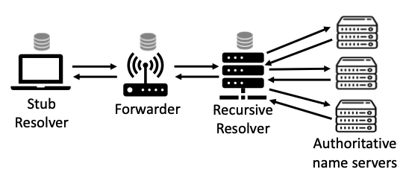
DNS infra and levels of caching
All layers have a cache and are subject to Cache poisoning attack
but most attacks focus only on resolvers!!
[ DNS Cache Poisoning Attack Reloaded: Revolutions with Side Channels ]
Notes:
Client initiates a DNS query – gethostbyname() to an OS stub resolver - resolv.conf (OS wide system cache)
Stub resolver forwards to Forwarder ( found in home wifi )
Forwarder forwards the query to the recursive resolver
Recursive resolver iteratively queries the auth nameserver
All layers have a cache and are subject to Cache poisoning attack but most attacks focus only on resolvers!!

Slide 14

Proposed Attack

Slide 15
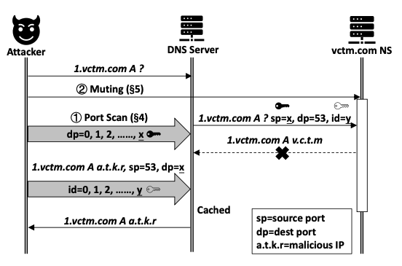
Attack Workflow
Trigger DNS query
Infer Source Port
Extend Attack Window
[ DNS Cache Poisoning Attack Reloaded: Revolutions with Side Channels ]
Notes:
To overcome source port randomization, they make use of a side channel in networking stack to scan and discover which srcports were used to initiate query.
Normally an outstanding query will receive a reply from the upstream server in a matter of tens or hundreds of milliseconds.
This is insufficient, given that the attacker needs time to infer the source port and to inject rogue DNS replies.
This paper attempts to extend the attack window greatly

Slide 16
Claim
“The proposed attack affects all layers of DNS caching
and defeats source port randomization defense”
Focus | DNS Forwarders and Resolvers
Attacker type | Off Path
Capabilities | IP Spoofing
Forwarder | Resolver
Attacker in LAN managed by a wireless router. Ex: Public wireless in coffee shop | Enterprise network attacker is an insider/ compromised machine. Even public resolvers work
Machine to trigger request from forwarder / resolver

Slide 17
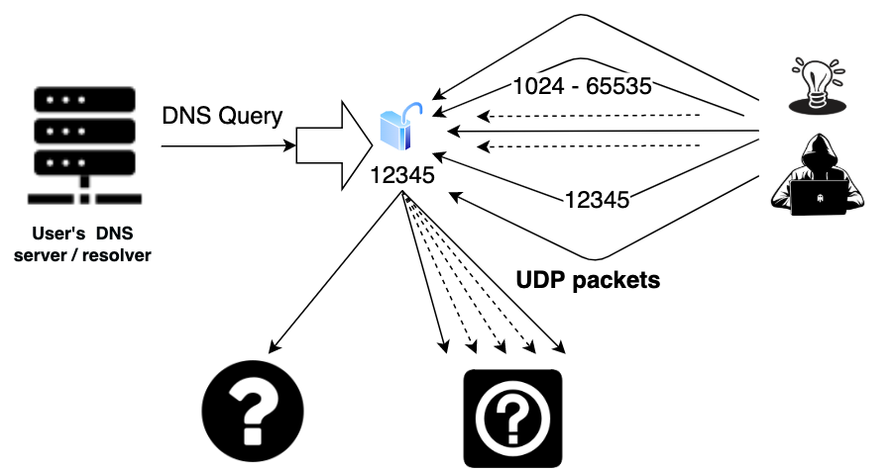
UDP is a stateless protocol.
RFC 8085 states that - “applications can receive packets from more than one IP source address on a single UDP socket”

Slide 18
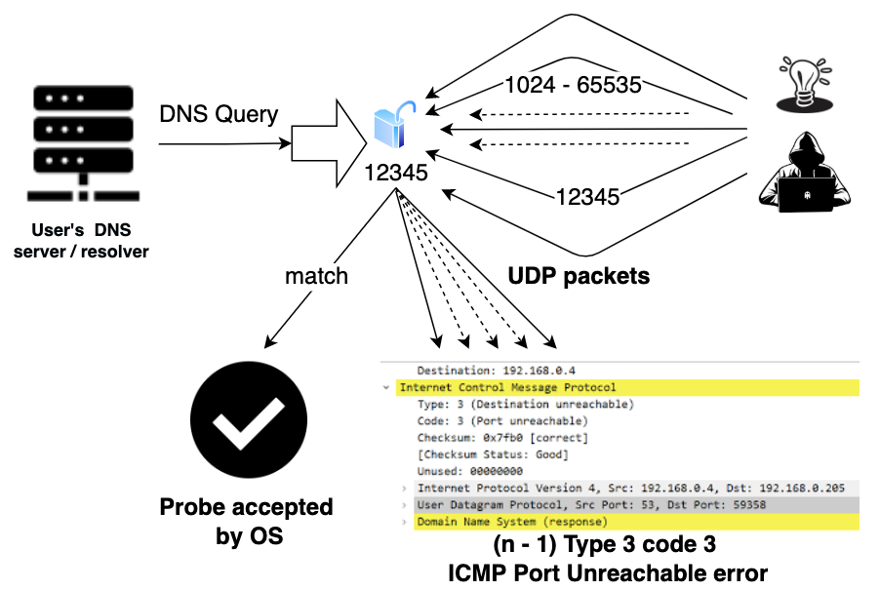
But there is a hurdle that has been injected in the stack to prevent fast UDP port scan!!

Slide 19
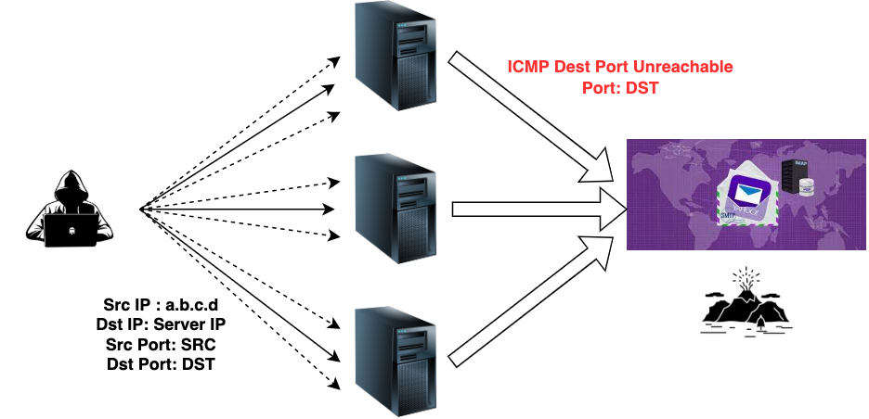
ICMP Rate Limit
Attacker target – Bring down yahoo.com(a.b.c.d)
Reflection attack

Slide 20
OS | Rate Limit
Linux | Per IP rate limit 1 Per second Max Burst = 6 Global rate limit 1000 per second periodic allowable burst of 50 https://github.com/torvalds/linux/commit/4cdf507d54525842dfd9f6313fdafba039084046 [vxs5308@submit-010 ~]$ sysctl -a | grep -i icmp_msgs net.ipv4.icmp_msgs_burst = 50 net.ipv4.icmp_msgs_per_sec = 1000 Follows a token bucket filter
MAC OS | 250
FreeBSD | 200
Windows Server | 200

Slide 21
Software Driven Protection against Port Scan
RFC 8085 further states – “Many operating systems also allow a UDP socket to be connected, i.e., to bind a UDP socket to a specific pair of addresses and ports”
modern socket APIs allow connect() on a UDP socket
OS accepts packets only based on filtered IP and port
Rejects with ICMP port unreachable in other cases
This effectively prevents the source port of a DNS query from being scanned directly.
Among dnsmasq, unbound and bind, only bind uses connect()

Slide 22

Part 1
Inferring DNS query source port

Slide 23
In absence of connect(), any IP can probe a source port(unbound, dnsmasq)
For faster scan : Need to bypass per IP rate limit
Case | Solution
Attacker owns multiple IP Addresses or single IPv6 address | Trivial to bypass In case of IPv6, Each LAN has /64 prefix 2^64 public IP addresses
Attacker owns only a single IPv4 address | Ask for multiple IP addresses using DHCP Ex: Home network
Attacker owns only a single IPv4 address, and above method fails | Leverage IP spoofing to bypass per IP rate limit Use global rate limit to infer the correct hit
Techniques to bypass per IP rate limit
Notes:
If an attacker owns a single IPv4 address and the above method fails for some reason (e.g., statically assigned IPs),
instead of spoofing 50 different IPs in each round of probing, we only need to use a single spoofed IP (or a 2nd IP the attacker owns) instead of many different IPs

Slide 24
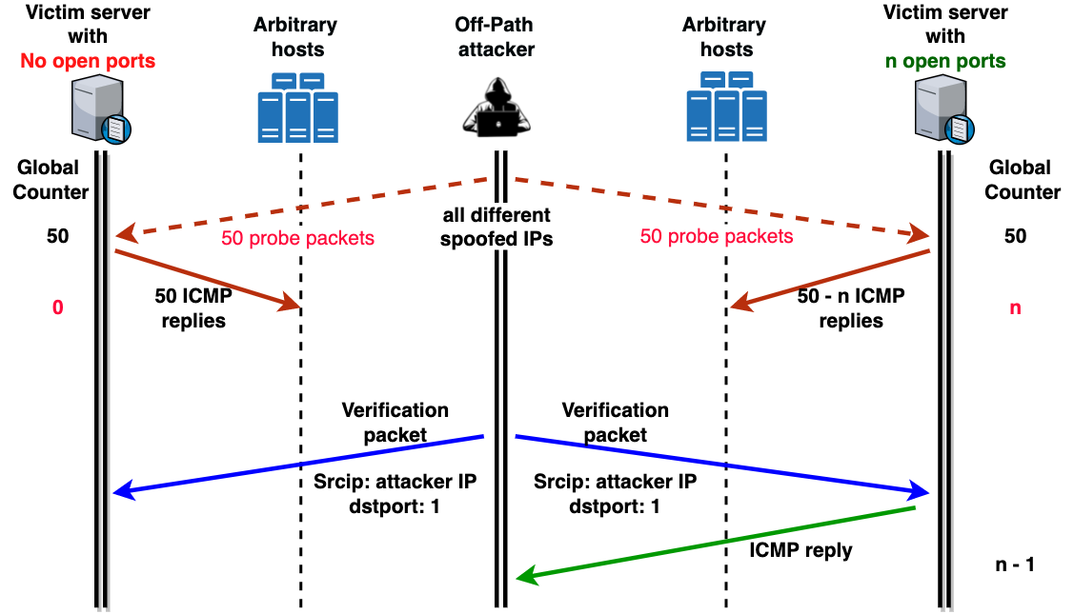
Fast Port Scanning of an Open Source Port
Effectively in 60+ seconds we can scan the entire port range
and attack can be repeated with better prob of success each time
[ Inspired by DNS Cache Poisoning Attack Reloaded: Revolutions with Side Channels ]
Notes:
The only thing the attacker has to make sure is to send 50 spoofed probing packets and the verification packet in a burst so that they are all processed within a 20𝑚𝑠 window.
otherwise, the victim may start recovering additional tokens.
The other requirement is that the attacker has to wait long enough for the 50 max tokens to recover
There are various other issues such as noises, packet reordering and delays in the network.
These can create both false positives or negatives but I haven’t covered it in this presentation.

Slide 25
Some things to consider
send 50 spoofed probing packets and the verification packet in a burst
so that they are all processed within a 20𝑚𝑠 window
otherwise, the victim may start recovering additional tokens
Wait for 50 max tokens to recover
Use Binary search to narrow down to the exact port
Other practical Issues
Noise, delay, packet reordering
Can result in false positives and negatives

Slide 26


Fast Port Scanning of a Private Source Port
connect() effectively makes a UDP port private to the remote peer
voids the previous method since IP spoofing won’t work.
Idea
Use the source IP of the upstream DNS server for spoofed DNS packets.
Repeat previous test with Auth NS IP + different source ports
Use global rate limit as the side channel

Slide 27


Per IP rate limit restricts it to a low speed of one port per second
But there was a catch in the implementation !!
global rate limit is checked prior to the per-IP rate limit
One global rate limit token gets deducted irrespective of per IP rate limit restriction
Was done to prevent the expensive per-IP-rate-limit check across RBL tree structure

Slide 28
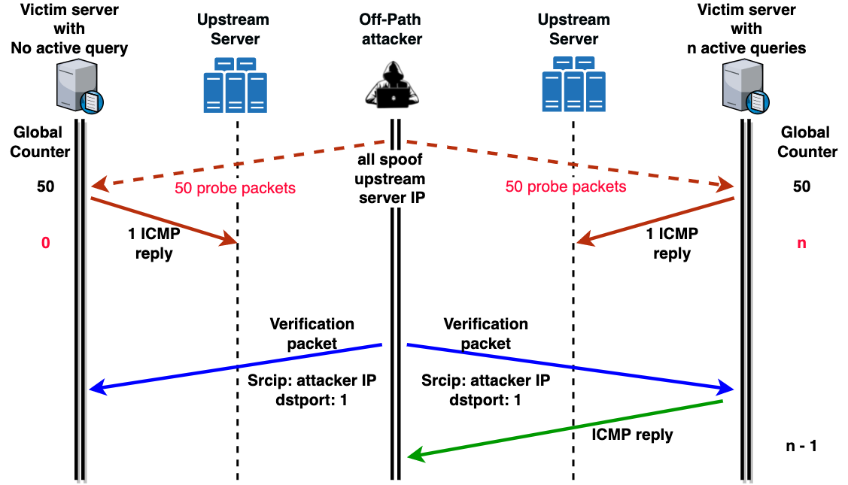
[ Inspired by DNS Cache Poisoning Attack Reloaded: Revolutions with Side Channels ]

Slide 29
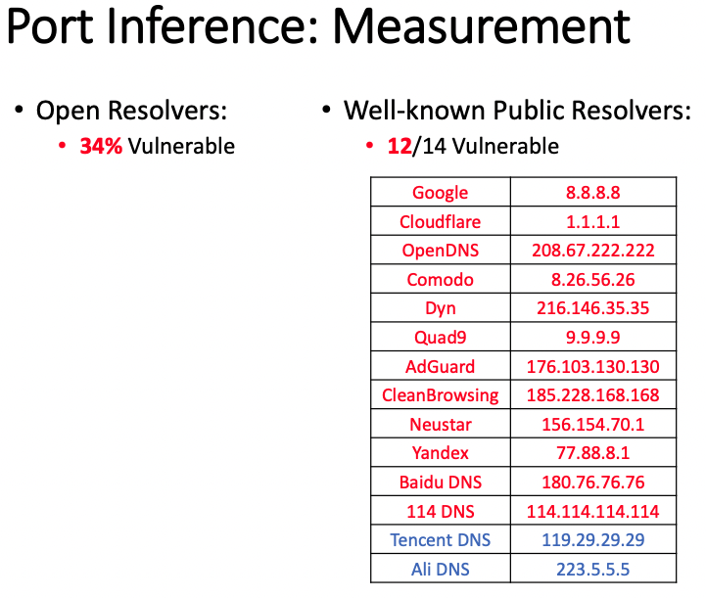

Slide 30

Part 2
Extending the attack window

Slide 31
“Injecting a rogue response is a race between attacker
and legitimate server”
( attack window ) ( #ports_to_scan ) ( time_to_inject_records )
Goal
Mute upstream server and prevent it from responding to
DNS queries triggered by the attacker!!

Slide 32
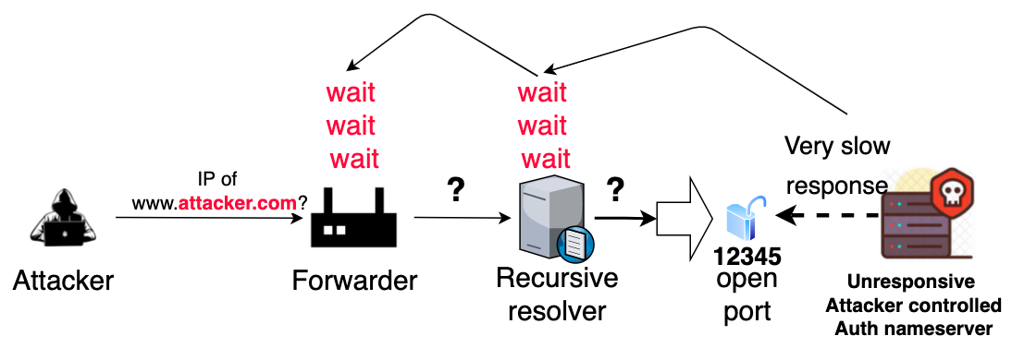
Extending Window in a Forwarder Attack
DNS forwarders completely trust upstream resolvers for response validation
Design choice to prevent duplication of effort
Notes:
Resolvers need to provide the final answer after dealing with all the CNAMEs and referrals

Slide 33
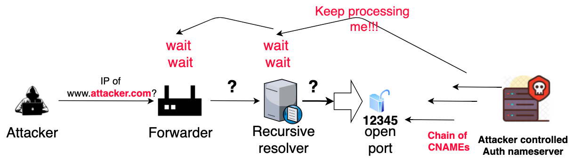
Most forwarders have a lenient timeout
dnsmasq : 1 min
Forwarder stops early if resolver fails first
Resolver timeout range : 5 to 30s
Triggers SERVFAIL or NXDOMAIN
Notes:
SERVFAIL
NXDOMAIN
While NXDOMAIN is the DNS server telling you that the domain doesn't exist,
a SERVFAIL is the DNS server telling you, “Hey, I can't give you the answer for that query.”
CNAME : Canonical names
maps one domain name(alias) to another canonical name
point ftp.example.com and www.example.com to example.com - this has the A record
if IP ever changes then we just need to update in one place in the network

Slide 34
Extending Window in a Resolver Attack
Part 1 : Background
Part 2 : Attack

Slide 35
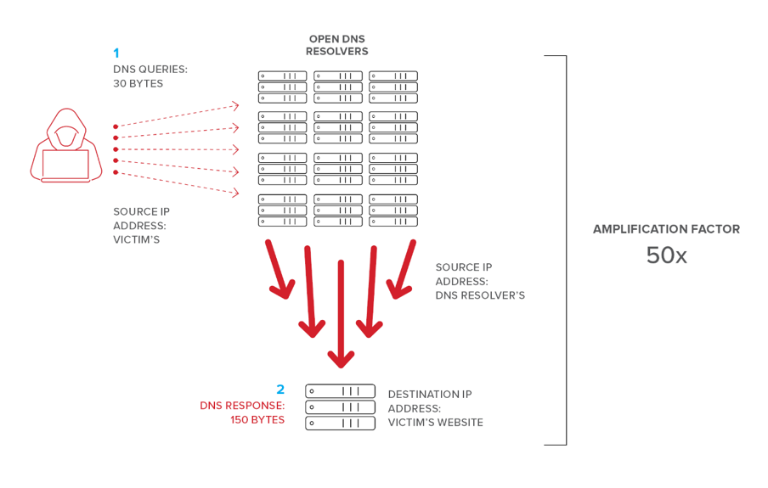
DNS amplification attack
https://www.f5.com/labs/articles/education/what-is-a-dns-amplification-attack-
Notes:
Responses per second. This is the maximum number of times the same response is given to a client within one second.
Errors per second. This is the maximum number of times an error response is sent to the same client within one second.
Window. This is the number of seconds for which responses to a client are suspended if too many requests are made.
Leak rate. This is how frequently the DNS server responds to a query during the time responses are suspended. For instance, if the server suspends responses to a client for 10 seconds, and the leak rate is 5, the server still responds to one query for every 5 queries sent. This allows the legitimate clients to get responses even when the DNS server is applying response rate limiting on their subnet or FQDN.
TC rate. This is used to tell the client to try connecting with TCP when responses to the client are suspended. For instance, if the TC rate is 3, and the server suspends responses to a given client, the server issues a request for TCP connection for every 3 queries received. Make sure the value for TC rate is lower than the leak rate, to give the client the option to connect via TCP before leaking responses.
Maximum responses. This is the maximum number of responses the server issues to a client while responses are suspended.
Allowlist domains. This is a list of domains to be excluded from RRL settings.
Allowlist subnets. This is a list of subnets to be excluded from RRL settings.
Allowlist server interfaces. This is a list of DNS server interfaces to be excluded from RRL settings.

Slide 36
Response rate limiting to the rescue!!
RRL offers various features to control the way a server responds to DNS requests from the same client
Prevents someone from using your server to trigger a DOS attack on someone else
When a limit is reached
responses are dropped or truncated

Slide 37
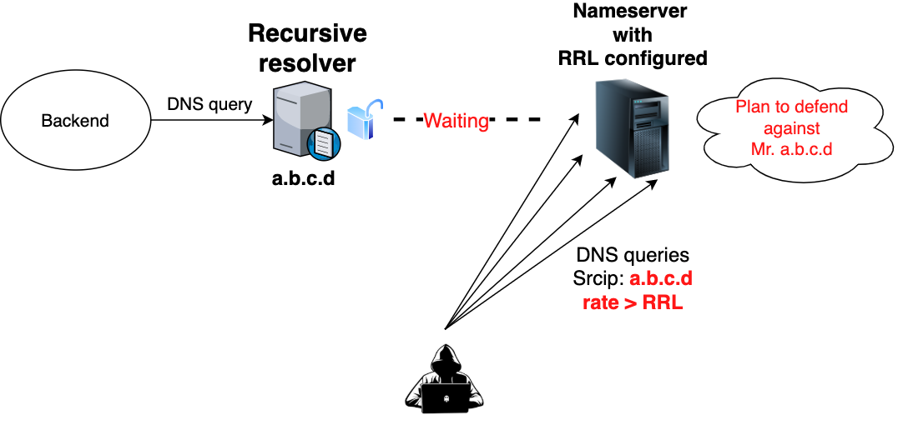
RRL : A hero once, now a villain!!
Trivial to create a sufficiently high “loss rate” so that the resolver’s legitimate query
has an extremely low probability of getting a response !!

Slide 38

Defenses

Slide 39
0x20 encoding
Randomization of capitalization of letters in the domain names
Issue
significant compatibility issues with auth name servers
DNS Sec
registrants digitally sign information they put into the DNS
need to be enabled on both resolver and authoritative server
Issue
only a small fraction of domains are signed
Very less % of the resolvers enabling DNSSEC actually validate the received records.
DNS Cookie option
DNS extension that allows client and server to exchange secrets unknown to the off-path attacker.
Needs resolver and auth server to upgrade.
BIND implements this feature
hasn’t been widely explored for compatibility issues
Notes:
DNS cookie is added in RDATA of OPT RR.
OPT RR pseudo-record that contains extra fields that are added later to DNS.

Slide 40
Ways to defend against proposed attacks
Source Port de-randomization | Attack window extension
disallow outgoing ICMP replies losing network troubleshooting features Address global rate limit randomize global rate limit randomize max allowable burst ( current 50 ) randomize minimum number of tokens recovered each time (current 20) randomize minimum idle time to recover tokens ( current 20 ms) randomize number of token recovered per time unit (current 1 per ms) Resolvers should adopt the use of connect() for their sockets prevents source ports from being directly scannable | Set aggressive timeouts for DNS queries (below 1s) short-lived source port Can trigger retransmissions and affect performance. Use anycast DNS make it harder for an attacker to DoS a specific authoritative name server used by a victim resolver.
Notes:
https://www.cloudflare.com/en-in/learning/dns/what-is-anycast-dns/
In Anycast, one IP address can apply to many servers. Anycast DNS means that any one of a number of DNS servers can respond to DNS queries, and typically the one that is geographically closest will provide the response. This reduces latency, improves uptime for the DNS resolving service, and provides protection against DNS flood DDoS attacks.

Slide 41

Related work

Slide 42
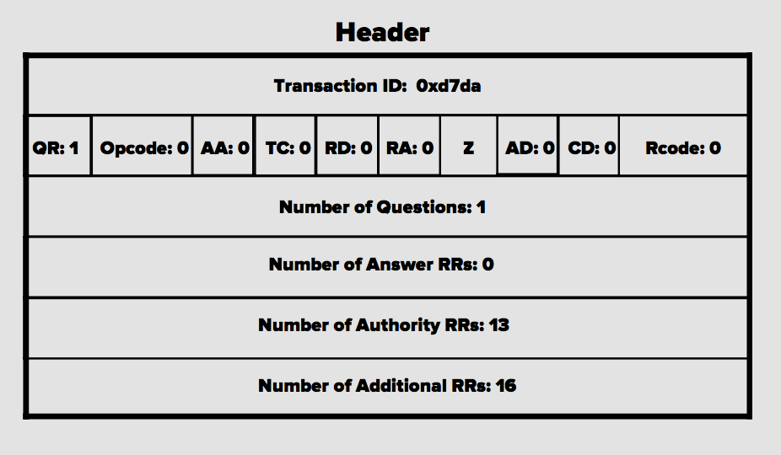
Defeat Source Port Randomization with Fragmentation Herbert and Shulman
Notes:
Fragmentation is considered one of the most troublesome feature in the industry
Has many hidden issues !!!
The randomness that’s needed for cache poisoning is concentrated in the beginning of the DNS message
UDP header and

Slide 43


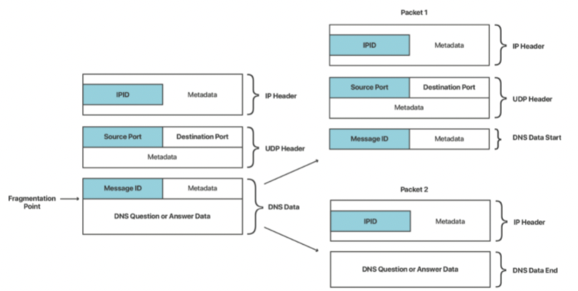
Split UDP datagram
First fragment - containing the message ID and source port
Second fragment – containing part of the DNS response.
Forge the second part and make
sure that the second forged fragment arrives at the resolver before true second fragment !!
Entropy reduced to 16 bits - IPID
[ https://blog.cloudflare.com/sad-dns-explained/ ]

Slide 44
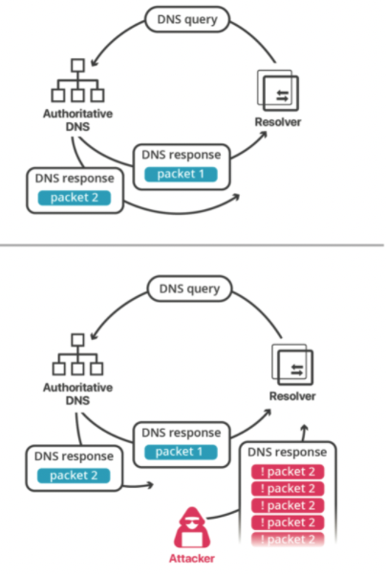
Inject ICMP fragmentation needed error messages from resolver to auth nameserver
proactively lowers MTU w.r.t resolver
PMTU table
IP | MTU
Resolver IP | 1000
IP | MTU
Resolver IP | 536
Fragmentation induced
[ https://blog.cloudflare.com/sad-dns-explained/ ]

Slide 45
Issues with this approach
Very difficult to find the perfect split
Perfect split is needed to ensure checksum correctness!!
Servers usually have a minimum configurable MTU size
Need to know the exact server configuration
Min MTU size could be larger than what’s needed for DNS response fragmentation
Predicting IPID has become more challenging over time
More randomness has been introduced

Slide 46

Questions?

